Slide 1
Splunk for K8S and Containers

Slide 2
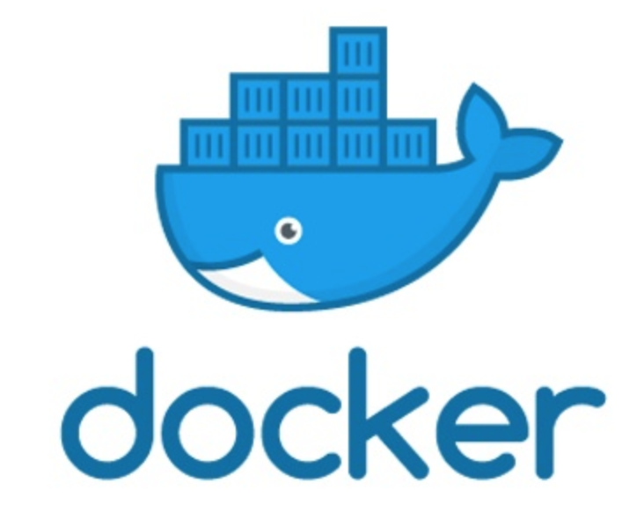
Splunk For Kubernetes
Why?
Help SE’s understand K8S technology by doing (and breaking)
Become conversant on each offering, how to best position and when to position each offering of observability suite
Help standup demo/lab environment to show customers – I don’t think we have one on oxygen
Help Guide (OR avoid) POVs to core strengths of observability suite (i.e. – applications running on Platform OR platform stability & granular metrics OR user experience on platform)
Notes:
Splunk Support now extended to Splunk Enterprise 7.2 (and greater) deployments in Docker containers.
Customer Pain Point: Enterprise customers (esp. large organizations) are increasingly deploying software in Docker containers. They’re asking to do this with Splunk, but until now, Splunk Support has not covered deployments in Docker.
Splunk Response: Splunk Customer Success now supports deployments of Splunk Enterprise 7.2 (or greater) in Docker containers.

Slide 3
Splunk For Kubernetes
Fast deployments. Easily expandable. Lower TCO.
LOGS - Splunk Connect for Kubernetes (SCK)
Easy deployment via SAI AND HELM
Collects
Logs – Cluster Logs
Metrics – using Splunk built fluentD inputs (metrics store)
Kubernetes Cluster Objects & metadata
METRICS - SignalFx Kubernetes Navigator - TBD
TRACING - Ominition Tracing -- TBD
Notes:
Splunk Support now extended to Splunk Enterprise 7.2 (and greater) deployments in Docker containers.
Customer Pain Point: Enterprise customers (esp. large organizations) are increasingly deploying software in Docker containers. They’re asking to do this with Splunk, but until now, Splunk Support has not covered deployments in Docker.
Splunk Response: Splunk Customer Success now supports deployments of Splunk Enterprise 7.2 (or greater) in Docker containers.

Slide 4
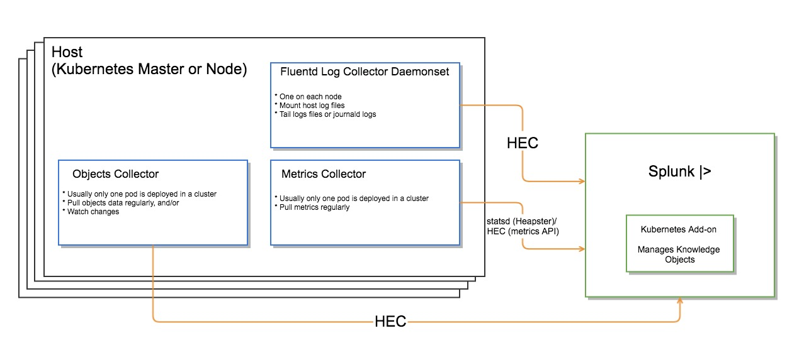
SCK Architecture

Slide 5
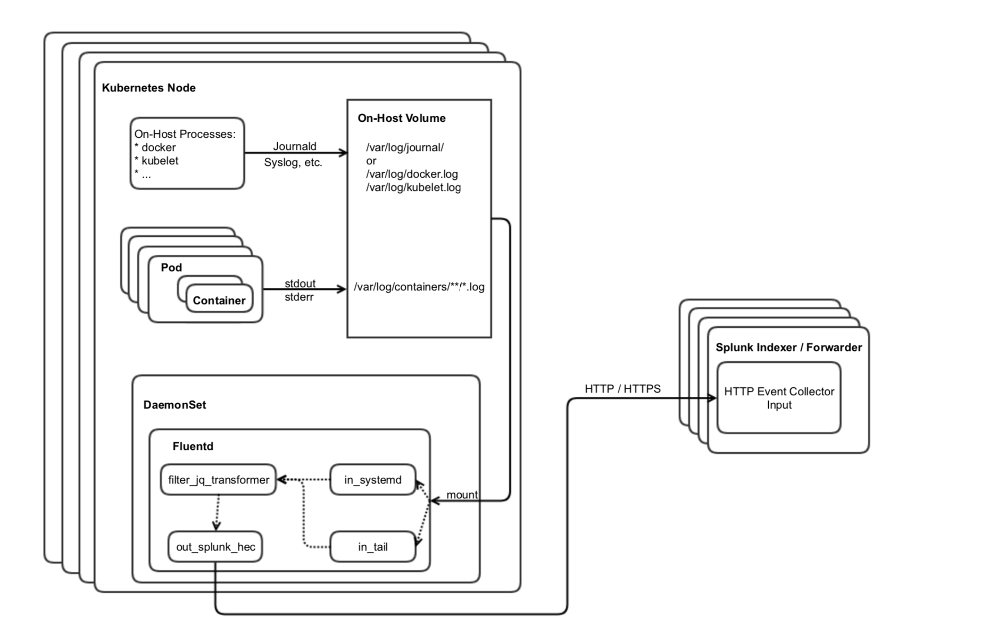
SCK Architecture - Logs
Event Logging topology
“Node Logging Agent” pattern
Deployed As Daemon Set
FluentD
Tail & SystemD inputs
JQ transformer – removes excess JSON object metadata
HEC output to splunk

Slide 6
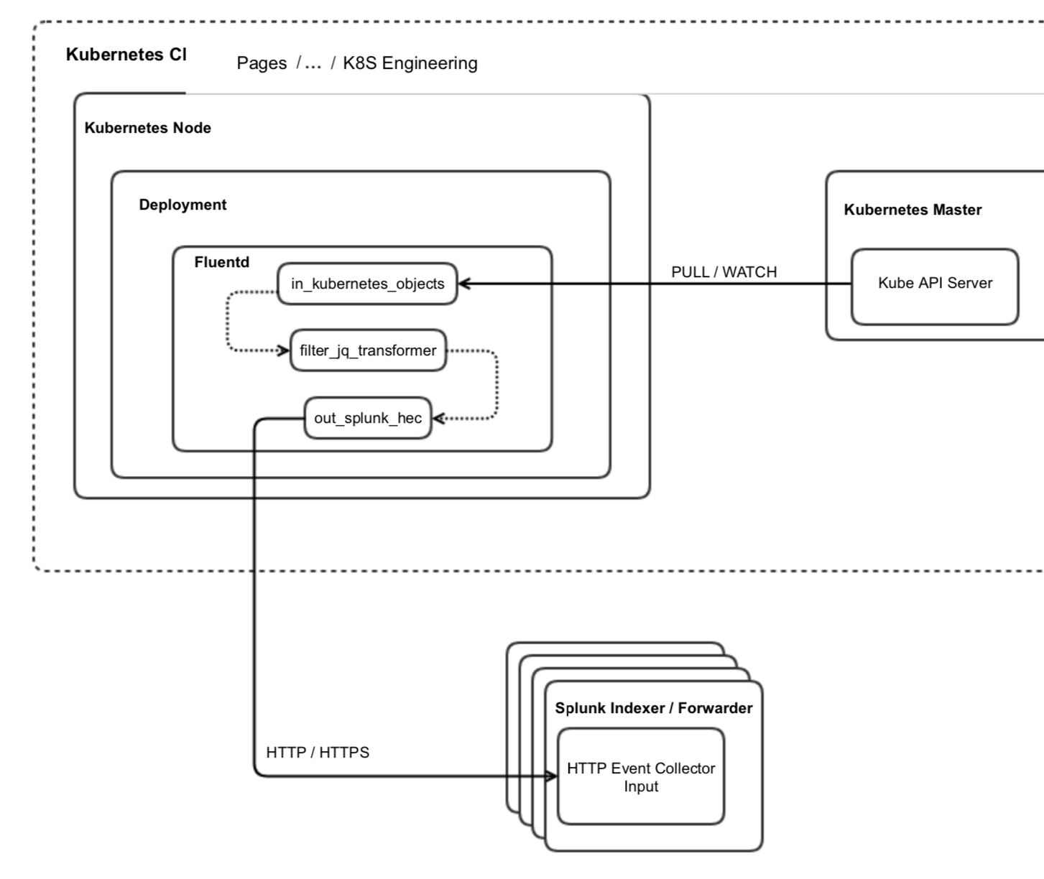
SCK Architecture - Meta
MetaData Logging topology
Deployment is cluster
Leverage K8S API endpoints to pull & watch
FluentD
Kubernetes objects
JQ transformer – removes excess JSON object metadata
HEC output to Splunk

Slide 7
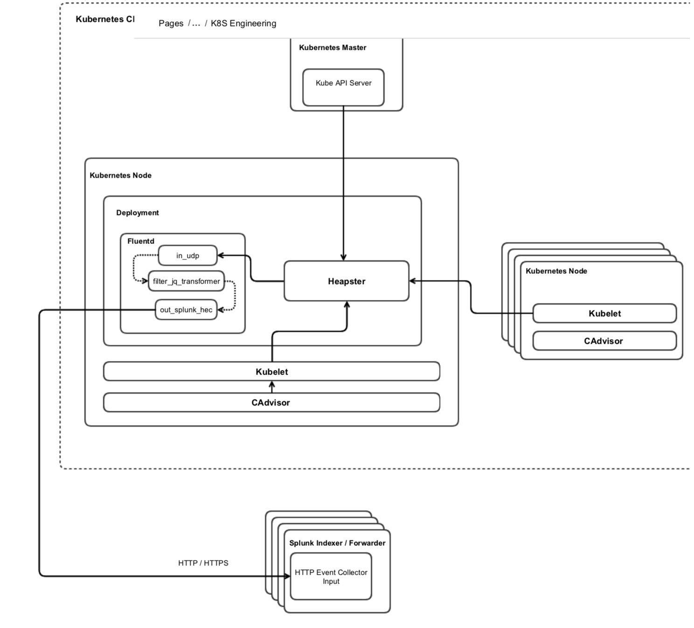
SCK Architecture - Metrics
MetaData Logging topology
Hooks into existing Metrics deployment within Cluster
FluentD
UDP input
JQ transformer – formats for direct ingestion into Metrics store
HEC output to Splunk

Slide 8
SignalFx for Kubernetes [PLACEHOLDER]
.
METRICS - SignalFx Kubernetes Navigator - TBD
Notes:
Splunk Support now extended to Splunk Enterprise 7.2 (and greater) deployments in Docker containers.
Customer Pain Point: Enterprise customers (esp. large organizations) are increasingly deploying software in Docker containers. They’re asking to do this with Splunk, but until now, Splunk Support has not covered deployments in Docker.
Splunk Response: Splunk Customer Success now supports deployments of Splunk Enterprise 7.2 (or greater) in Docker containers.

Slide 9
SignalAPM for Kubernetes [Placeholder]
Notes:
Splunk Support now extended to Splunk Enterprise 7.2 (and greater) deployments in Docker containers.
Customer Pain Point: Enterprise customers (esp. large organizations) are increasingly deploying software in Docker containers. They’re asking to do this with Splunk, but until now, Splunk Support has not covered deployments in Docker.
Splunk Response: Splunk Customer Success now supports deployments of Splunk Enterprise 7.2 (or greater) in Docker containers.

Slide 10
Deploy Splunk observability HowTo guide
EKS OR BYOC
Enable K8S
Install HELMK8s
Install Splunk operator
Installing companion k8s App
Deploy Splunk Connect for Kubernetes (SCK)
Using Git
Deploy SignalFx Agent
Sign up for SignalFx free trial
Install SignalAgent in K8S w/ helm
Ominition Tracing – longer term TBD
Deploy opencensus/monition HipsterStore
???
Profit
Notes:
Splunk Support now extended to Splunk Enterprise 7.2 (and greater) deployments in Docker containers.
Customer Pain Point: Enterprise customers (esp. large organizations) are increasingly deploying software in Docker containers. They’re asking to do this with Splunk, but until now, Splunk Support has not covered deployments in Docker.
Splunk Response: Splunk Customer Success now supports deployments of Splunk Enterprise 7.2 (or greater) in Docker containers.

